Slide 1

Stability and Fixed points of dynamical systems
Daniel Arovas , Phys Dept., University of California, San Diego
Steven Strogatz : Nonlinear Dynamics and Chaos,

Slide 2
Stability and Fixed points of dynamical systems
$\frac{du}{dt}=f\left(u\right)$

Slide 3
Stability and Fixed points of dynamical systems
$\frac{du}{dt}=f\left(u\right)$

Slide 4
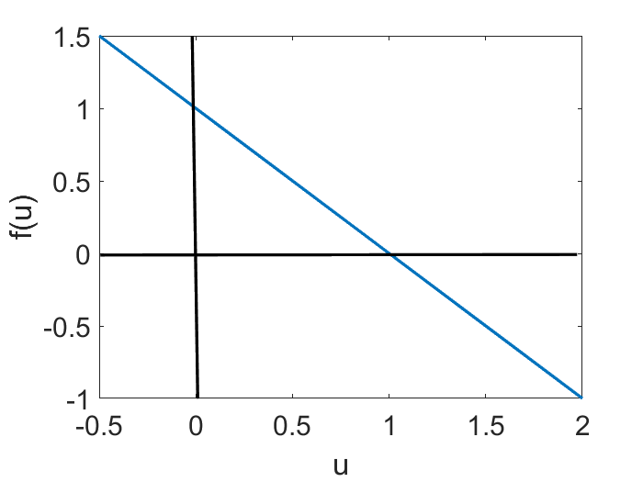
Stability and Fixed points of dynamical systems (vector flow)
$\frac{du}{dt}=f\left(u\right)$
$a=b=1$

Slide 5
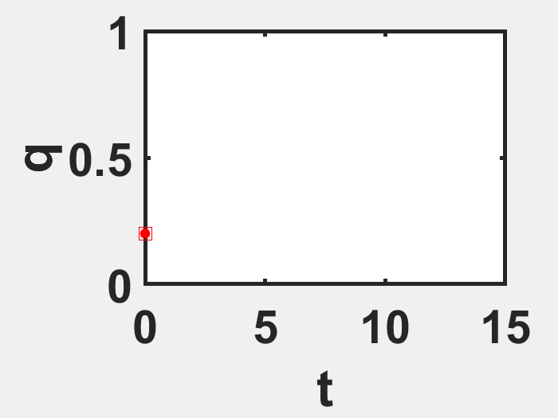
Stability and Fixed points of dynamical systems (Model 1)
$\frac{du}{dt}=f\left(u\right)$
$u$

Slide 6
Numerical Solution with Euler Method

Slide 7
Basics: Numerical techniques (Derivative of a function)
$f\left(x_{0}+h\right)=f\left(x_{0}\right)+hf^{′}\left(x_{0}\right)+\frac{h^{2}}{2!}f^{′′}\left(x_{0}\right)+…+\frac{h^{n}}{n!}f^{n}\left(x_{0}\right)+R_{n}\left(x\right)$
For the first derivative
Denotes the difference between Talylor Polynomial of degree and the original function
$f\left(x_{0}+h\right)=f\left(x_{0}\right)+hf^{′}\left(x_{0}\right)+R_{1}\left(x\right)$
Samll
$Lt_{h→0}\frac{f\left(x_{0}+h\right)−f\left(x_{0}\right)}{h}=f^{′}\left(x_{0}\right)$

Slide 8
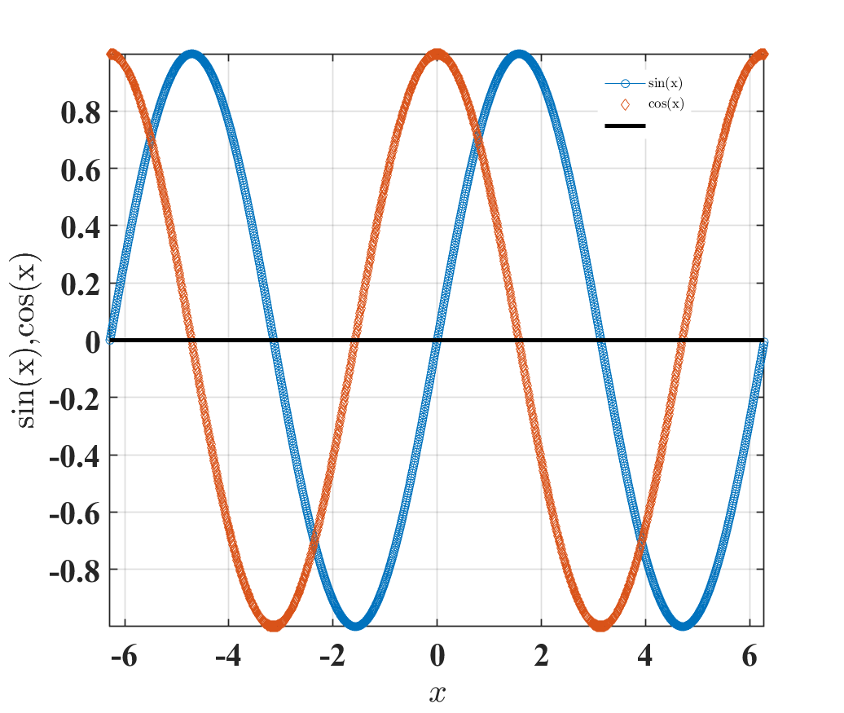
Numerical techniques
$f\left(x_{0}+h\right)=f\left(x_{0}\right)+hf^{′}\left(x_{0}\right)+\frac{h^{2}}{2!}f^{′′}\left(x_{0}\right)+…+\frac{h^{n}}{n!}f^{n}\left(x_{0}\right)+R_{n}\left(x\right)$
$Lt_{h→0}\frac{f\left(x_{0}+h\right)−f\left(x_{0}\right)}{h}=f^{′}\left(x_{0}\right)$
x=-2*pi:0.01:2*pi;
h=0.01;
f=sin(x);
g= (sin(x+h)-sin(x))./h;
plot(x,f,'-o');
hold on;
plot(x,g,'d');
legend 'sin(x)' 'cos(x)'
z=zeros(1,length(x));
hold on;
plot(x,z,'k','linewidth',3);

Slide 9
$f\left(x_{0}+h\right)=f\left(x_{0}\right)+hf^{′}\left(x_{0}\right)+\frac{h^{2}}{2!}f^{′′}\left(x_{0}\right)+…+\frac{h^{n}}{n!}f^{n}\left(x_{0}\right)+R_{n}\left(x\right)$
We can use central differences as well.
$f\left(x_{}+h\right)=f\left(x_{}\right)+hf^{′}\left(x_{}\right)$
$f\left(x_{}−h\right)=f\left(x_{}\right)−hf^{′}\left(x_{}\right)$
$\frac{f\left(x_{}+h\right)−f\left(x_{}−h\right)}{2h}=f′\left(x\right)$
Here we can obtain second order of accuracy as term will be cancelled.

Slide 10
Euler’s Method: Tangent Line Approximation
For our first order initial value problem
an alternative is to compute approximate values of the solution y = φ(t) at a selected set of t-values.
Ideally, the approximate solution values will be accompanied by error bounds that ensure the level of accuracy.
In this section, we examine the tangent line method, which is also called Euler’s Method.
$y^{′}=f\left(t,y\right),y\left(t_{0}\right)=y_{0},$

Slide 11
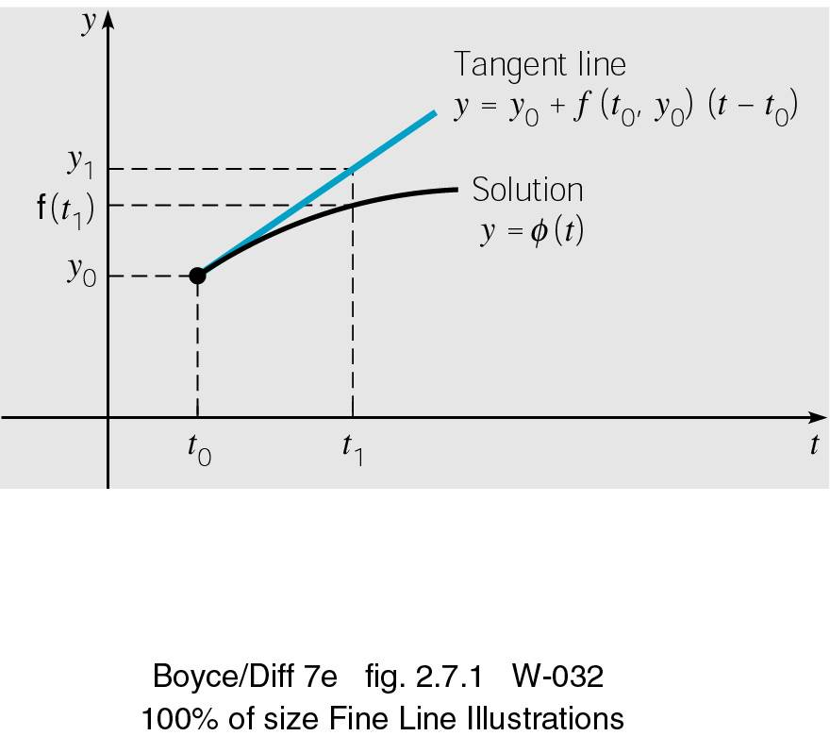
Euler’s Method: Tangent Line Approximation
For the initial value problem
approximating solution: y = φ(t) at initial point t₀.
The line tangent to solution at initial point is thus
Thus, if t₁ is close enough to t₀,
we can approximate φ(t₁) by
$y^{′}=f\left(t,y\right),y\left(t_{0}\right)=y_{0},$
$y=y_{0}+f\left(t_{0},y_{0}\right)\left(t−t_{0}\right)$
$y_{1}=y_{0}+f\left(t_{0},y_{0}\right)\left(t_{1}−t_{0}\right)$
Notes:
The solution passes through initial point (t₀, y₀) with slope
f (t₀, y₀).

Slide 12
Euler’s Method: Tangent Line Approximation
For a point t₂ close to t₁, we approximate φ(t₂) using the line passing through (t₁, y₁) with slope f (t₁, y₁):
Thus we create a sequence y_{n} of approximations to φ(t_{n}):
where f_{n} = f (t_{n}, y_{n}).
For a uniform step size h = t_{n} – t_{n-1}, Euler’s formula becomes
$y_{2}=y_{1}+f\left(t_{1},y_{1}\right)\left(t_{2}−t_{1}\right)$
$y_{1}=y_{0}+f_{0}⋅\left(t_{1}−t_{0}\right)$
$y_{n+1}=y_{n}+f_{n}h,n=0,1,2,…$

Slide 13
Numerical errors
Discretization error:
Error resulting from the computation of quantities that have been calculated using an approximation to the true solution
We may neglect higher order terms for example
This error is sometimes called truncation error
Unavoidable problem in numerical integration work
Would occur even in the presence of infinite precision
Round-off error
Result of finite precision arithmetic

Slide 14
Euler’s Method: Model 1
x0=0.2;
y0=[x0];
%[t,y]=ode45(@(t,y) stability_ex1(t,y,a,b),[0,tspan], y0);%[ 2.5 0 1 0]);
init = [x0 y0]; % y0 = [v0, w0]
t = linspace(0,10,500)';
% Runge-Kutta 4th-Order Algorithm
y_euler = zeros(length(t), 2);
y_euler(1, :) = init;
h = t(2)-t(1);
for i = 2:length(t)
k1 =stability_ex1(t(i-1), y_euler(i-1, :),a,b);
y_euler(i, :) = y_euler(i-1, :)+h*k1;
End
function [yprime] = stability_ex1(t,y,a,b)
y_prime=zeros(1,1);
yprime(1) = a-b*y(1);
yprime=yprime';
end

Slide 15
Stability and Fixed points of dynamical systems (linear stability analysis)

Slide 16
Stability and Fixed points of dynamical systems (linear stability analysis)
$\overset{˙}{u}=f\left(u\right)$
Perturbing around the fixed points:
$\overset{˙}{u}+\overset{˙}{ε}=f\left(u+ε\right){\left.\right|}_{u=u^{∗}}=f\left(u^{∗}\right)+εf^{′}\left(u^{∗}\right)+\frac{ε^{2}}{2!}f^{′′}\left(u^{∗}\right)+O\left(ε^{3}\right)$

Slide 17
Stability and Fixed points of dynamical systems
$\overset{˙}{u}=f\left(u\right)$
Perturbing (small and linear) around the fixed points:
$\overset{˙}{u}+\overset{˙}{ε}=f\left(u+ε\right){\left.\right|}_{u=u^{∗}}=f\left(u^{∗}\right)+εf^{′}\left(u^{∗}\right)+\frac{ε^{2}}{2!}f^{′′}\left(u^{∗}\right)+O\left(ε^{3}\right)$
$\overset{˙}{ε}=εf^{′}\left(u^{∗}\right)$
The perturbation grows if and decreases if
Dropping higher order terms we obtain
Or

Slide 18
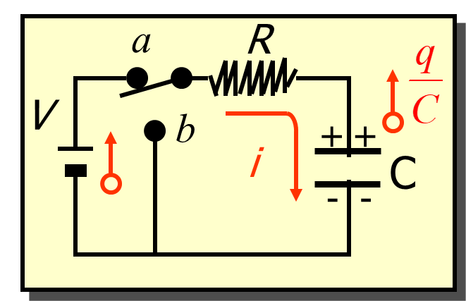
RC Circuit: Charging Capacitor (Model 2)
Interpreting a differential equation as a vector field Flows on the Line
$V_{0}−\frac{q}{C}=iR$
$V_{0}$
Q: What will be the asymptotic value of ?
$R\frac{dq}{dt}=V_{0}−\frac{q}{C}$

Slide 19
RC Circuit: Charging Capacitor
Interpreting a differential equation as a vector field Flows on the Line
$V_{0}−\frac{q}{C}=iR$
$V_{0}$
$\int_{0}^{q}{\frac{dq}{\left(CV_{0}−q\right)}}=\int_{o}^{t}{\frac{dt}{RC}}$
$R\frac{dq}{dt}=V_{0}−\frac{q}{C}$
$ln\left(CV_{0}−q\right)−ln\left(CV_{0}\right)=\frac{−t}{RC}$
At time
$ln\frac{\left(CV_{0}−q\right)}{CV_{0}}=\frac{−t}{RC}$
At time
$q=CV_{0}\left(1−e^{−t/{RC}}\right)$
The charge q rises from zero initially to its maximum value

Slide 20
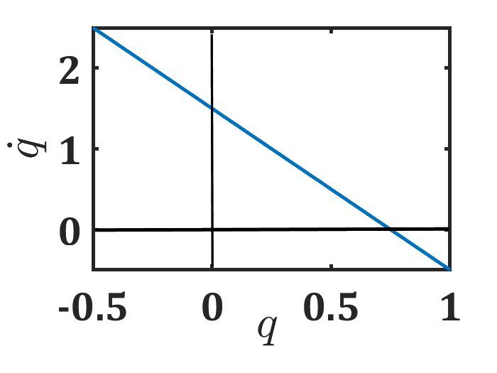
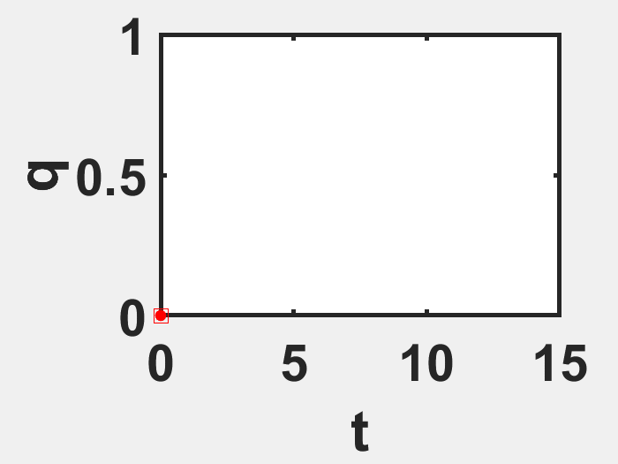
Interpreting a differential equation as a vector field Flows on the Line
$f\left(q\right)$
Solution
$f\left(q\right)>0$
$q^{∗}$
$f\left(q\right)<0$
$V_{0}=1.5;C=0.5;R=1$

Slide 21
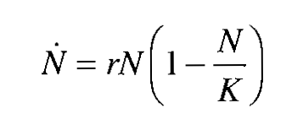
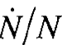
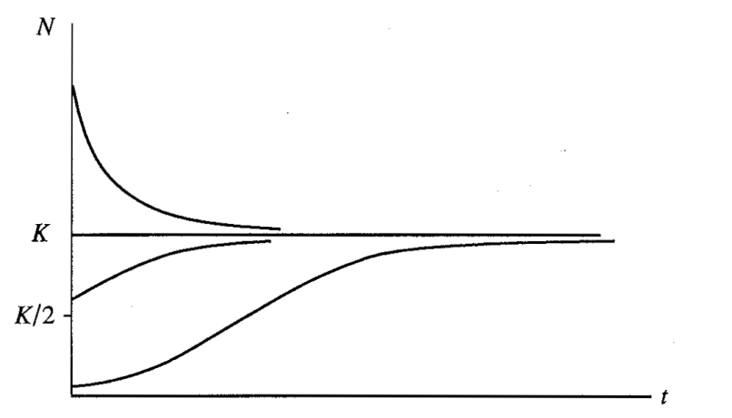
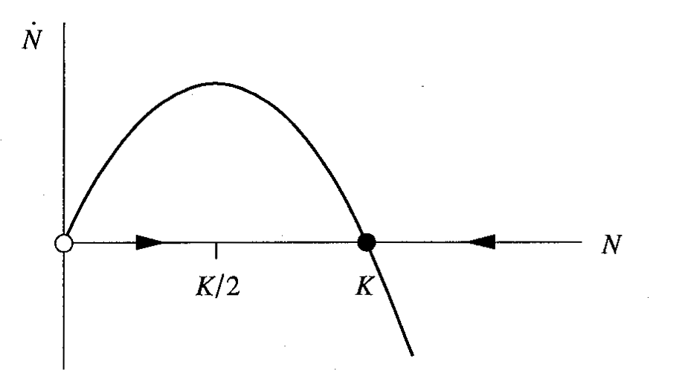
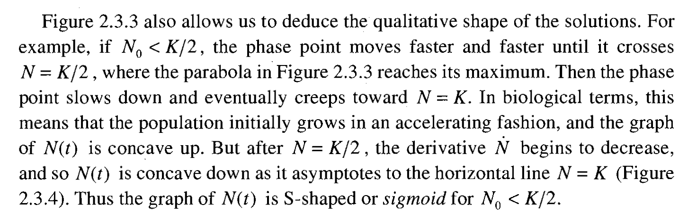
Logistic equation (Model 3)
Interpreting a differential equation as a vector field Flows on the Line
Analysis of Fixed points
Per Capita Growth Rate
Carrying Capacity

Slide 22
Fixed Points and stability
Linear stability in 1-d model: Logistic equations, CR circuit
2-d linear model (concept of star, node, line of fixed points,
and saddle points) ***
General description (Role of trace and determinant)
Love affairs Romeo and Juliet
Fixed points and Linearization of 2-d systems (concept of Jacobian)
Rabit vs Sheep
Lotka-Volterra competition model
SIR model
High dimensional systems
Double pendulum
Lorenz attractor
*** Numerical method: Euler, RK-4

Slide 23
Interpreting differential eqn as vector field

Slide 24
Interpreting differential eqn as vector field (Model 4)
If we think x as position of a particle moving along real line and as velocity vector, then the differential equation represents the vector-field: it dictates the velocity at each

Slide 25
Elementary Physics Problems :vibrations of a mass hanging from a spring (Model 5)
$m\frac{ⅆ^{2}x}{ⅆt^{2}}+kx=0$
As we have to deal with nonlinear ode , we have to understand the vector field.
To find the vector field we will detect the state of the systems in each time i.e current position and velocity.
The systems (left) assign a vector at each point and therefore represents a vector field on the phase plane.
Plot it
$\frac{ⅆx}{ⅆt}=v$
$\frac{ⅆv}{ⅆt}=−\frac{k}{m}x=ω^{2}x$
Strogatz, Chapter 5

Slide 26
Elementary Physics Problems :vibrations of a mass hanging from a spring
$m\frac{ⅆ^{2}x}{ⅆt^{2}}+kx=0$
As we have to deal with nonlinear ode , we have to understand the vector field.
To find the vector field we will detect the state of the systems in each time i.e current position and velocity.
The systems (left) assign a vector at each point and therefore represents a vector field on the phase plane (, here ).
Plot it
$\frac{ⅆx}{ⅆt}=v$
$\frac{ⅆv}{ⅆt}=−\frac{k}{m}x={−ω}^{2}x$
Start with when you are on the x-axis:
Then
Thus for positive the vectors points vertically downward, opposite effect in the negative axis.
Now, you are on the -axis:
Then
Thus for positive , the vector filed points to the right, and to the left if

Slide 27
Elementary Physics Problems :vibrations of a spring hanging from a spring
$m\frac{ⅆ^{2}x}{ⅆt^{2}}+kx=0$
Start with when you are on the x-axis:
Then
Thus for positive the vectors points vertically downward, opposite effect in the negative axis.
Now, you are on the -axis:
Then
Thus for positive , the vector filed points to the right, and to the left if
$\frac{ⅆx}{ⅆt}=v$
$\frac{ⅆv}{ⅆt}=−\frac{k}{m}x=ω^{2}x$
The imaginary flow swirls about the origin.
The origin is like an eye of hurricane, if someone starts there will remain there: FP
(static equilibrium in Physics !!!)
Someone starts not from origin will circulate about the origin.
When the x is most negative, is zero, the spring is fully compresses, and then becomes positive and the spring comes to the equilibrium position (), with a large positive , thus it overshoots the spring.

Slide 28
Elementary Physics Problems :vibrations of a mass hanging from a spring
$m\frac{ⅆ^{2}x}{ⅆt^{2}}+kx=0$
$\frac{ⅆx}{ⅆt}=v$
$\frac{ⅆv}{ⅆt}=−\frac{k}{m}x=ω^{2}x$
The imaginary flow swirls about the origin.
The origin is like a eye of hurricane, if someone starts there will remain there: FP
(static equilibrium in Physics !!!)
Someone starts not from origin will circulate about the origin, eventually reaching to that IC:
When the x is most negative, is zero, the spring is fully compresses, and then becomes positive and the spring comes to the equilibrium position (), with a large positive , thus it overshoots the spring.
The shape of the orbit: not a circle.
It is actually an ellipse. Why????
is constant (conservation of energy)

Slide 29
2-d linear model (concept of star, node, line of fixed points, and saddle points)
$\frac{ⅆx}{ⅆt}=Ax$
$A=\left(\begin{matrix}a & b \\ c & d\end{matrix}\right)$
$A=\left(\begin{matrix}a & 0 \\ 0 & −1\end{matrix}\right)$

Slide 30
2-d linear model (concept of star, node, line of fixed points, and saddle points) (Model 6)
$\frac{ⅆx}{ⅆt}=Ax$
$A=\left(\begin{matrix}a & b \\ c & d\end{matrix}\right)$
$A=\left(\begin{matrix}a & 0 \\ 0 & −1\end{matrix}\right)$
$\frac{ⅆx}{ⅆt}=ax$
$\frac{ⅆy}{ⅆt}=−y$
$x=x_{0}e^{at}$
$y=y_{0}e^{−t}$
When , decays (actually both) exponentially. Therefore, both will reach to zero.

Slide 31
2-d linear model (concept of star, node, line of fixed points, and saddle points)
When , decays (actually both) exponentially. Therefore both will reach to zero.
Case 1: Along x , it decays faster compared to y. Starting from far away point, the trajectory approaches to the origin tangent to the slower direction (y-direction) .
Stable Node

Slide 32
2-d linear model (concept of star, node, line of fixed points, and saddle points)
When , decays (actually both) exponentially. Therefore both will reach to zero.
Case 1: Along x , it decays faster compared to y. Starting from far away point, the trajectory approaches to the origin tangent to the slower direction (y-direction) .
Stable Node
When , decays (actually both) exponentially. Therefore, both will reach to zero.
Case 2: The decay rates are precisely equal for both. Thus trajectories are straight line passing through origin.
Called as star.

Slide 33
2-d linear model (concept of star, node, line of fixed points, and saddle points)
Case 3: -1<Along y , it decays faster compared to x. Starting from far away point, the trajectory approaches to the origin tangent to the slower direction (x-direction) .
Stable Node

Slide 34
2-d linear model (concept of star, node, line of fixed points, and saddle points)
Case 3: -1<Along y , it decays faster compared to x. Starting from far away point, the trajectory approaches to the origin tangent to the slower direction (x-direction) .
Stable Node
Case 4: a, for long term evaluation.
So lines of fixed points

Slide 35
2-d linear model (concept of star, node, line of fixed points, and saddle points)

Slide 37


Overall Target
Numerical solution of nonlinear ordinary
differential equations
Modelling disease, emergence of chaos,
chaos in physical systems
Me after every single differential equations test.

